Slide 1
MUSIC RECORD DATABASE
SUBMITTED BY-
SARTHAK BAJAJ-19BCE0710 (SLOT-D1)
KHUSHI AGRAWAL-19BCE0418 (SLOT-D1)
AVIRAL GOYAL-19BCE0883 (SLOT-D1)

Slide 2
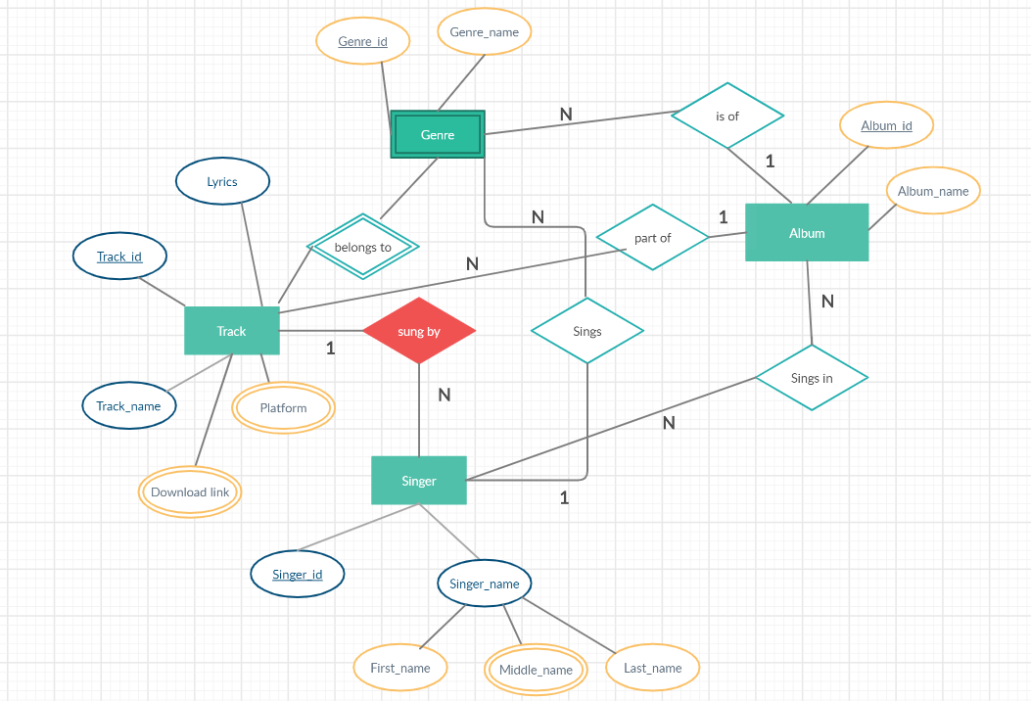
ER-DIAGRAM

Slide 3
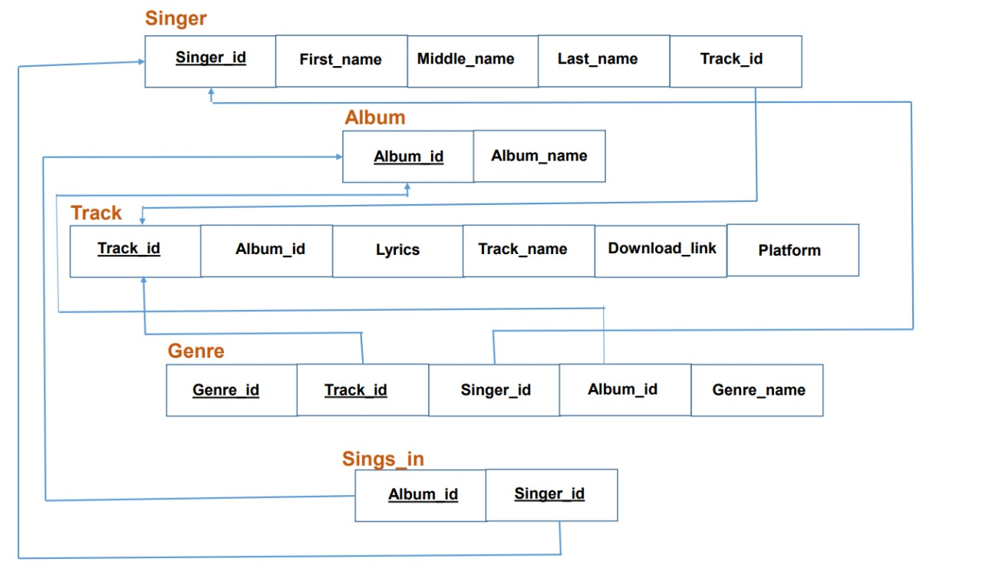
INITIAL DATABASE

Slide 4
FUNCTIONAL DEPENDENCY
Singer_id -> first_name, last_name, middle_name
Track_id -> singer_id
Album_id -> album_name
Album_id -> track_id
Track_id -> lyrics, track_name, download_link, platform
Track_id -> genre_id,
Album_id -> genre_id
Singer_id -> genre_id
Album_id,Singer_id,Track_id -> genre_id
Genre_id -> genre_name

Slide 5
Removing redundancy from functional dependency
Singer_id -> first_name
Singer_id -> middle_name
Singer_id -> last_name
Track_id -> singer_id
Album_id -> album_name
Album_id -> track_id
Track_id -> lyrics
Track_id -> track_name
Track_id -> download_link
Track_id -> platform
Singer_id -> genre_id
Genre_id -> genre_name

Slide 6
NORMALIZING TABLES
The attribute middle_name in the table singer and the attribute platform of the table track is multivalued so to normalize these in 1NF we convert each one of them into a new table
SINGER(Singer_id, first_name, last_name, track_id)
MIDDLE_NAME(Singer_id,middle_name)
TRACK(Track_id, album_id, Track_name, lyrics, download_link)
PLATFORM(Track_id, platform)
Now all our tables are already in 2NF as there is no partial dependency in table or we can also say that all the non prime attributes are fully functional dependent on candidate key.

Slide 7
Now some tables are not in 3NF, so converting these tables in 3NF:
In table SINGER as Track_id -> singer_id , therefore a separate table attribute Track_id , singer_id is needed.
Therefore SINGER(Singer_id, first_name, last_name)
SINGER2(Singer_id, track_id) are required tables after normalization
In table TRACK as Album_id -> track_id, therefore a separate table
for attribute Album_id , track_id is needed.
Therefore TRACK(Track_id, Track_name, lyrics, download_link)
TRACK2(Track_id, album_id) are required tables after normalization.
In table GENRE as Singer_id -> genre_id, Track_id -> singer_id,
Album_id -> track_id therefore a separate tables are needed.
Therefore GENRE(Genre_id, genre_name), GENRE2(Genre_id, Singer_id),
GENRE3(Track_id,,Album_id), GENRE4(Singer_id, Track_id)
Now all the tables are converted to 3NF but now all the tables are in BCNF also.

Slide 8
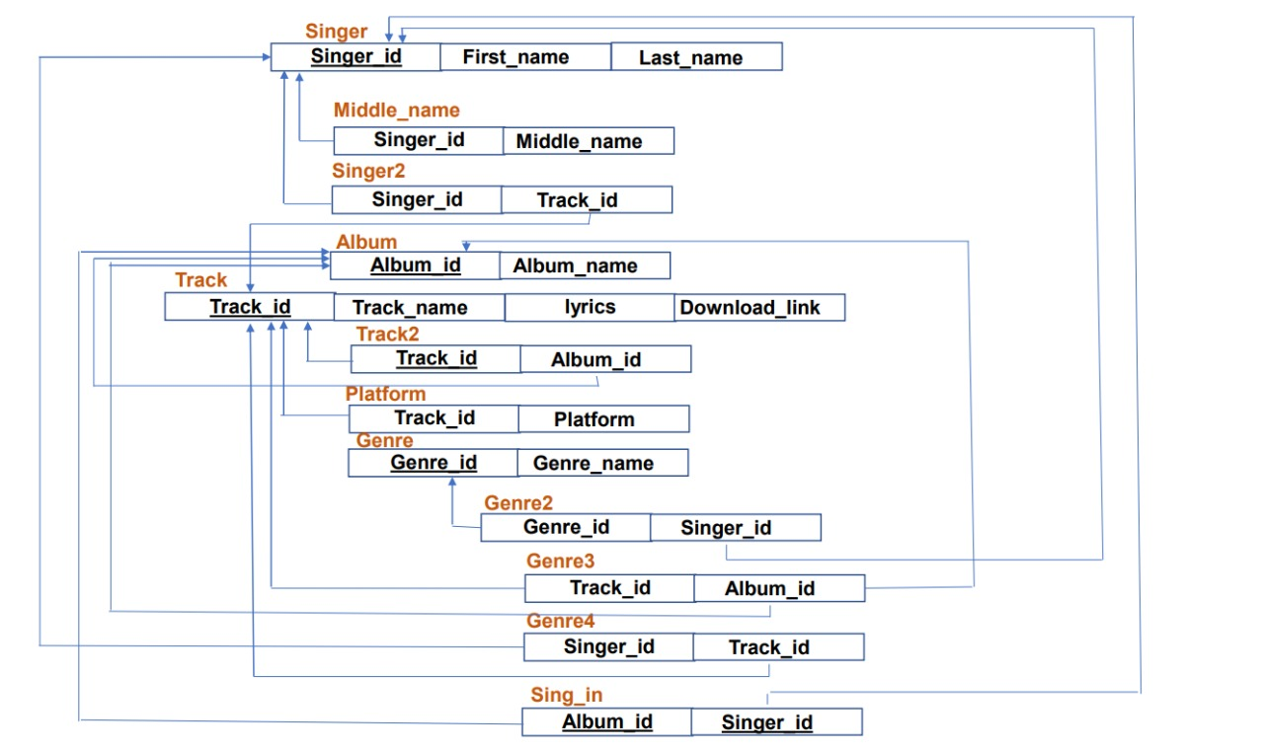
So the final schema after normalization is

Slide 9
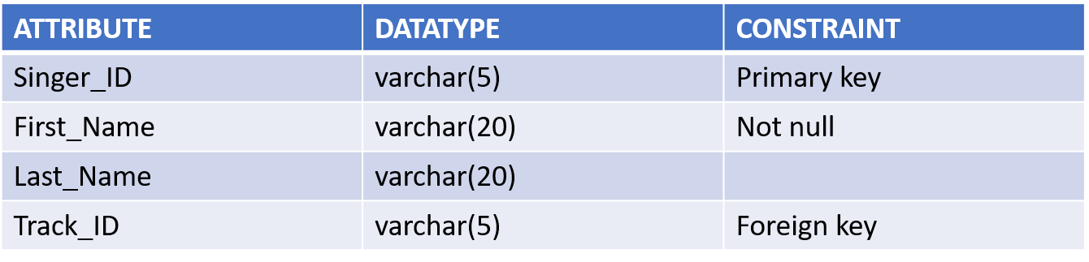
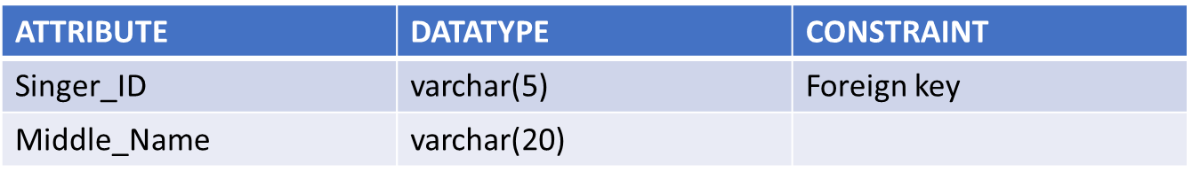
TABLES AND CONSTRAINTS
SINGER
MIDDLE NAME

Slide 10
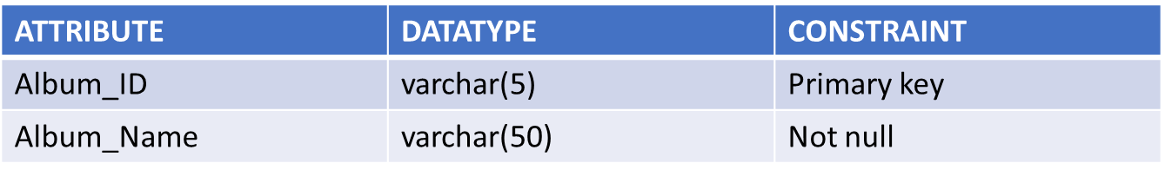
SINGER2
ALBUM
ATTRIBUTE | DATATYPE | CONSTRAINT
Singer_id | VARCHAR(5) | NOT NULL/ FOREIGN KEY
Track_id | VARCHAR(5) | NOT NULL/ FOREIGN KEY

Slide 11
TRACK
TRACK2
ATTRIBUTE | DATATYPE | CONSTRAINT
Track_id | VARCHAR(5) | Primary Key
Track_name | VARCHAR(50) | NOT NULL
Lyrics | BLOB
Download_link | BLOB
ATTRIBUTE | DATATYPE | CONSTRAINT
Track_id | VARCHAR(5) | PRIMARY KEY/ FOREIGN KEY
Album_id | VARCHAR(5) | NOT NULL/ FOREIGN KEY

Slide 12
PLATFORM
GENRE
ATTRIBUTE | DATATYPE | CONSTRAINT
Track_id | VARCHAR(5) | NOT NULL/ FOREIGN KEY
Platform | VARCHAR(50) | NOT NULL
ATTRIBUTE | DATATYPE | CONSTRAINT
Genre_id | VARCHAR(5) | PRIMARY KEY
Genre_name | VARCHAR(50) | NOT NULL

Slide 13
GENRE2
GENRE3 is same as TRACK2
GENRE4 is same as SINGER2
SINGS_IN
ATTRIBUTE | DATATYPE | CONSTRAINT
Genre_id | VARCHAR(5) | NOT NULL/ FOREIGN KEY
Singer_id | VARCHAR(5) | NOT NULL/FOREIGN KEY
ATTRIBUTE | DATATYPE | CONSTRAINT
Album_id | VARCHAR(5) | NOT NULL/ FOREIGN KEY
Singer_id | VARCHAR(5) | NOT NULL/ FOREIGN KEY

Slide 14
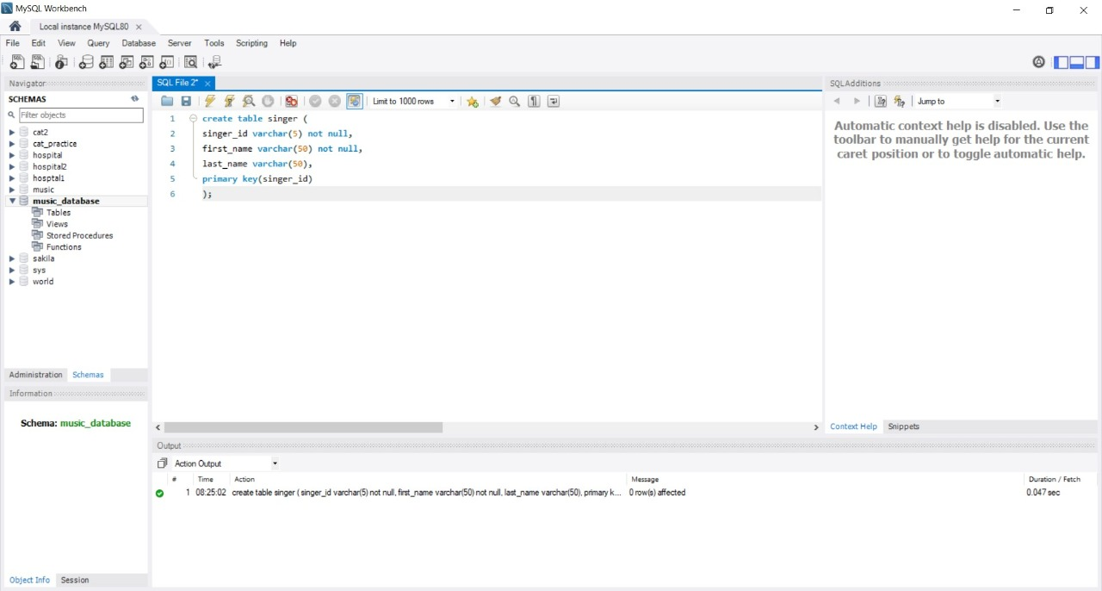
TABLE CREATION IN SQL
SINGER

Slide 15
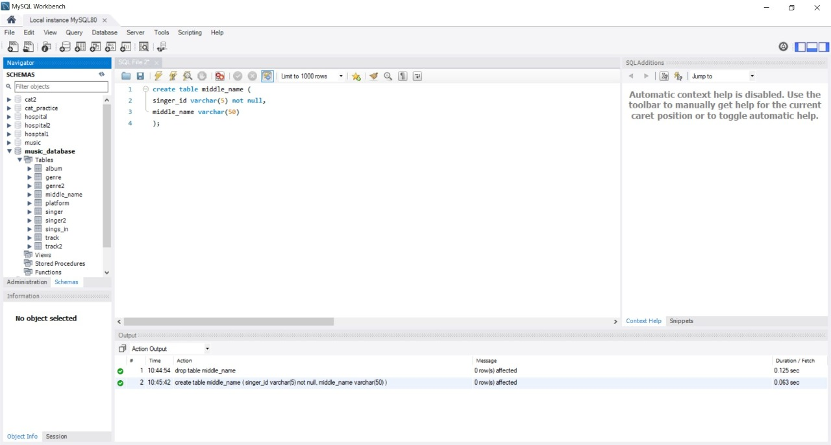
MIDDLE_NAME

Slide 16
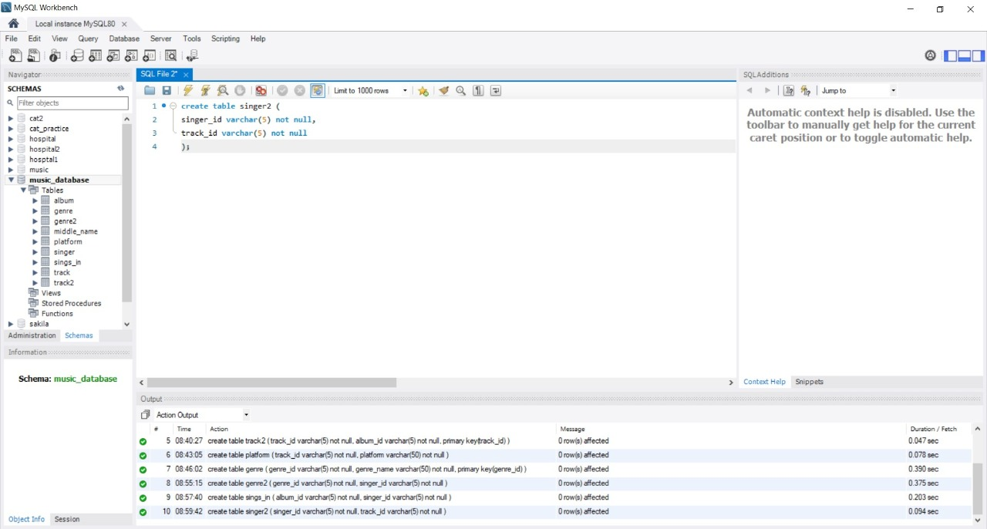
SINGER2

Slide 17
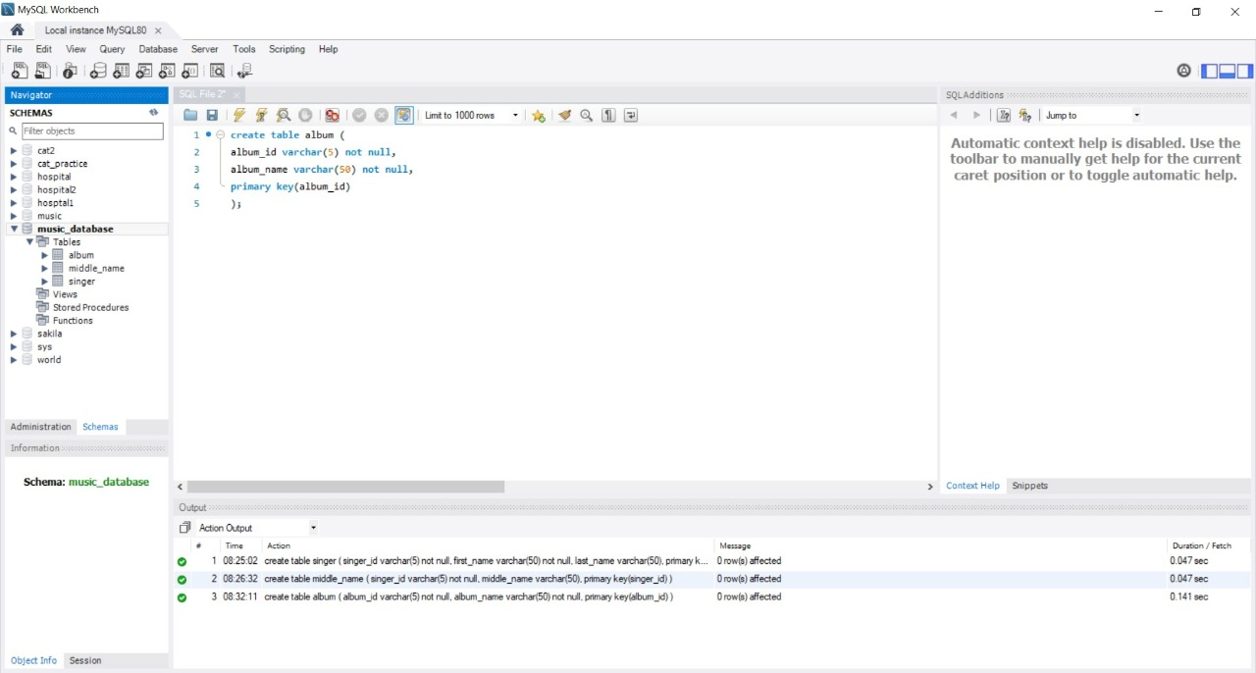
ALBUM

Slide 18
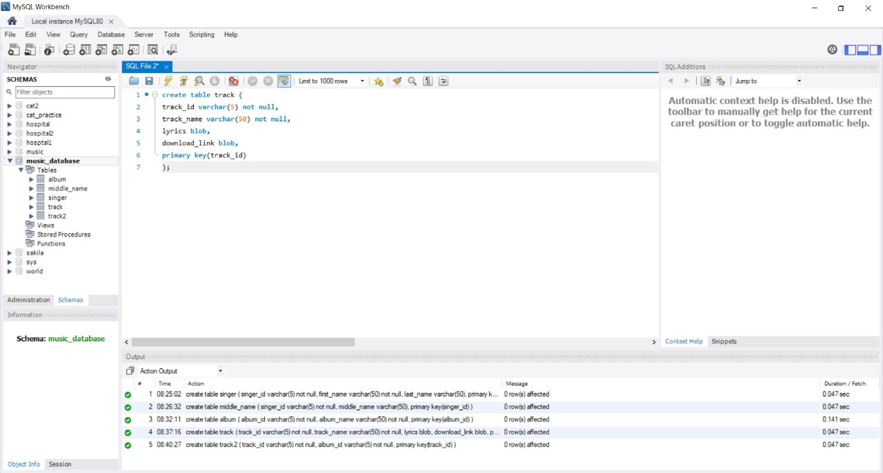
TRACK

Slide 19
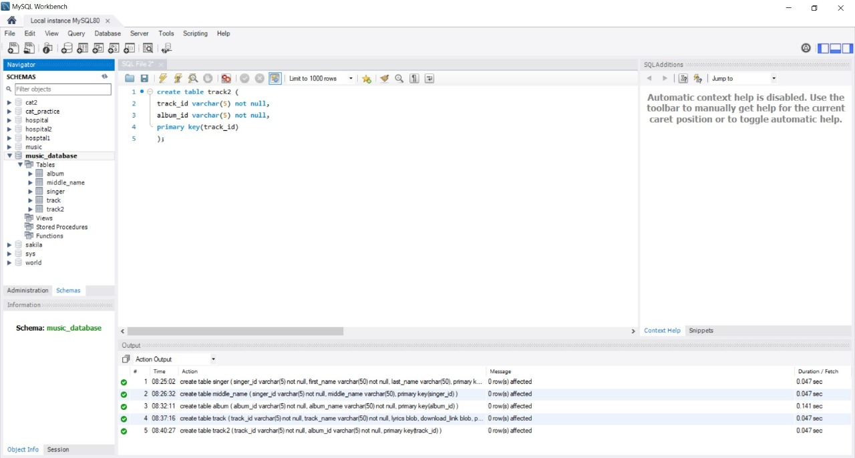
TRACK2

Slide 20
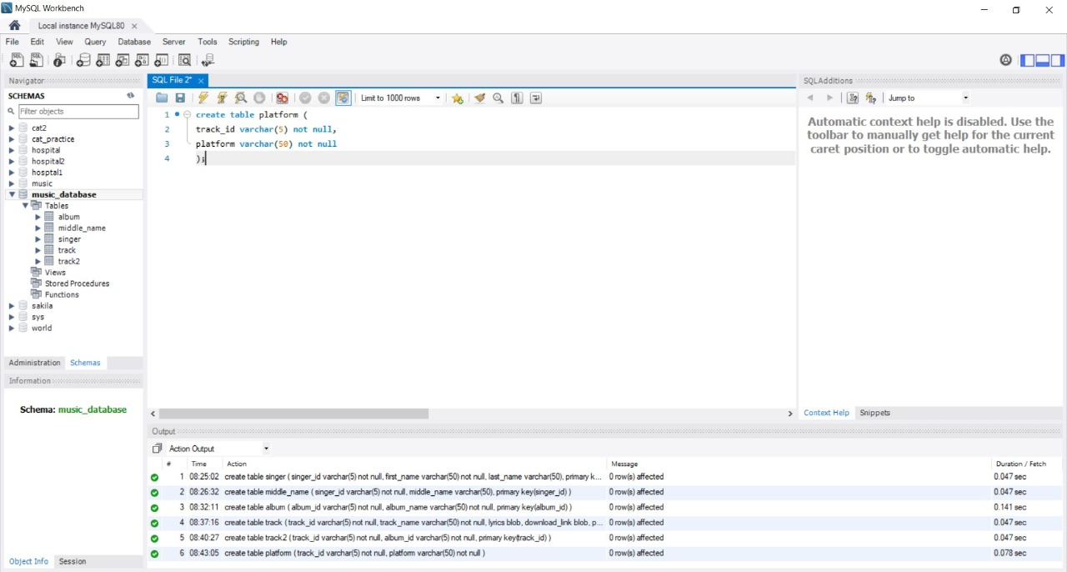
PLATFORM

Slide 21
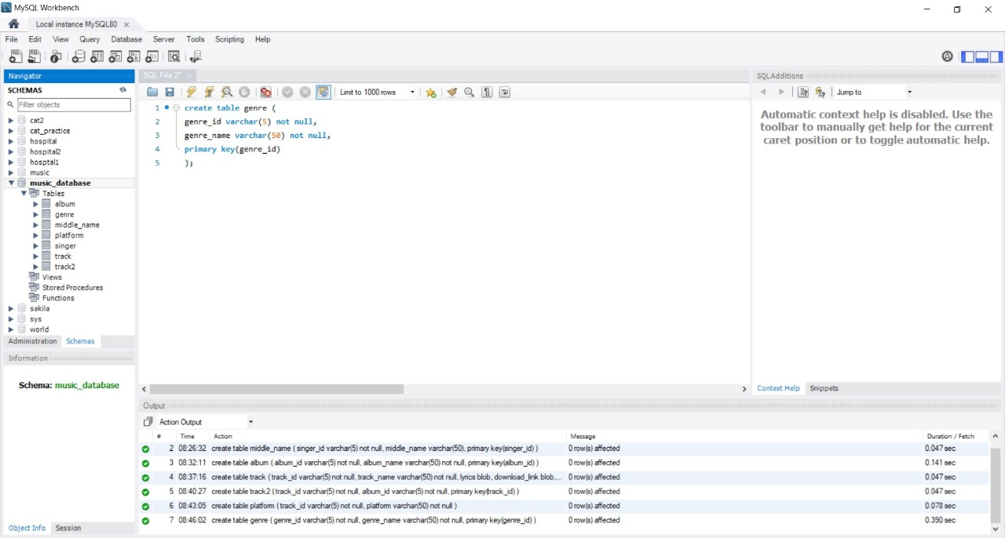
GENRE

Slide 22
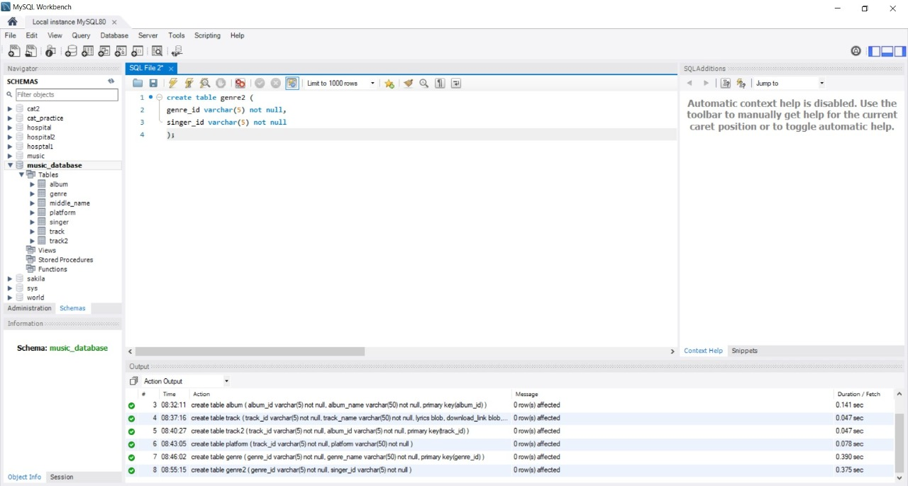
GENRE2

Slide 23
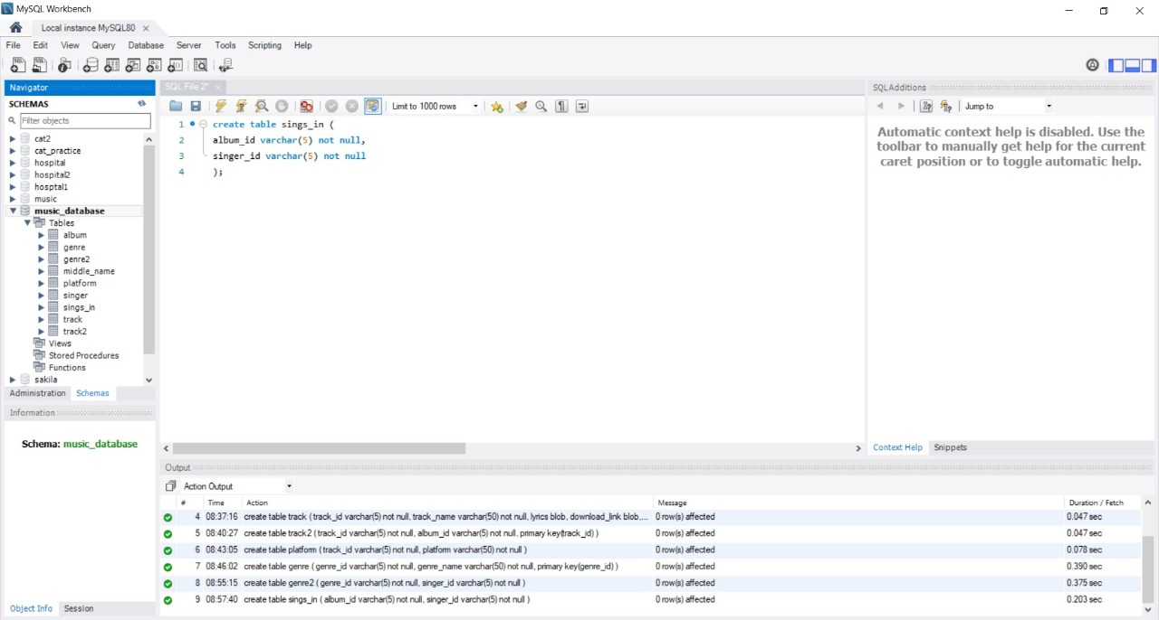
SINGS_IN

Slide 24
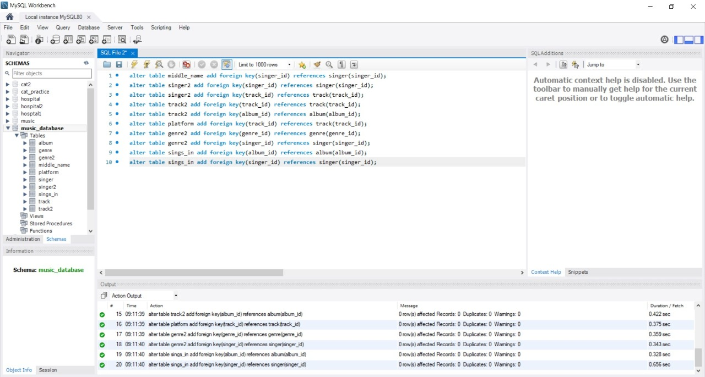

Slide 25
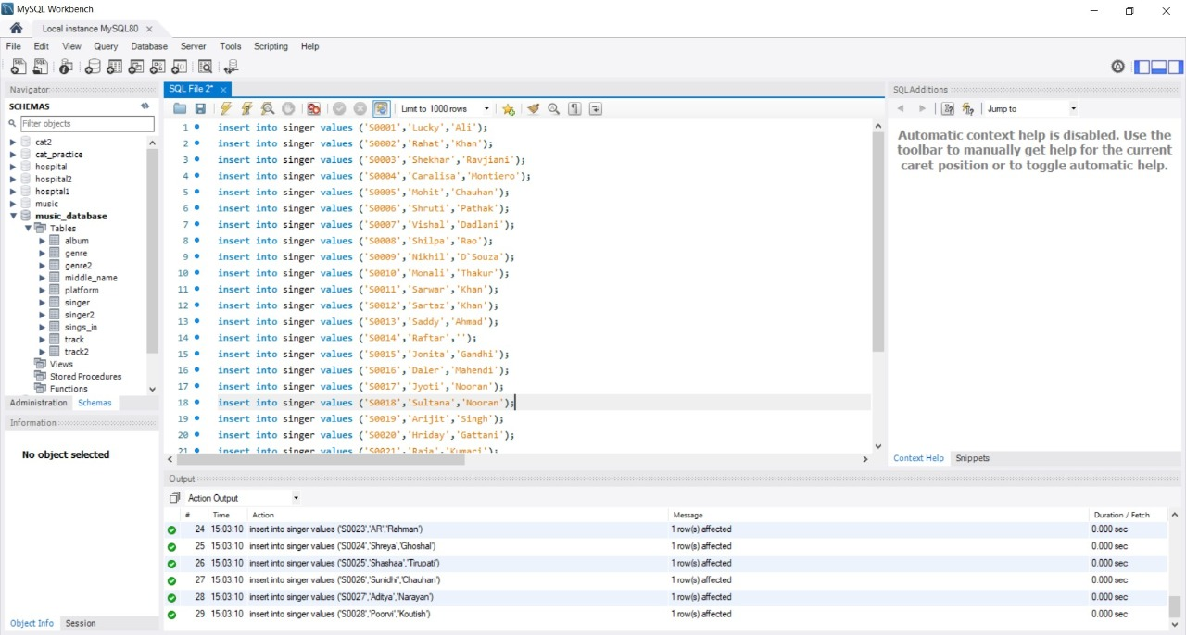
ADDING VALUES TO TABLES
SINGER

Slide 26
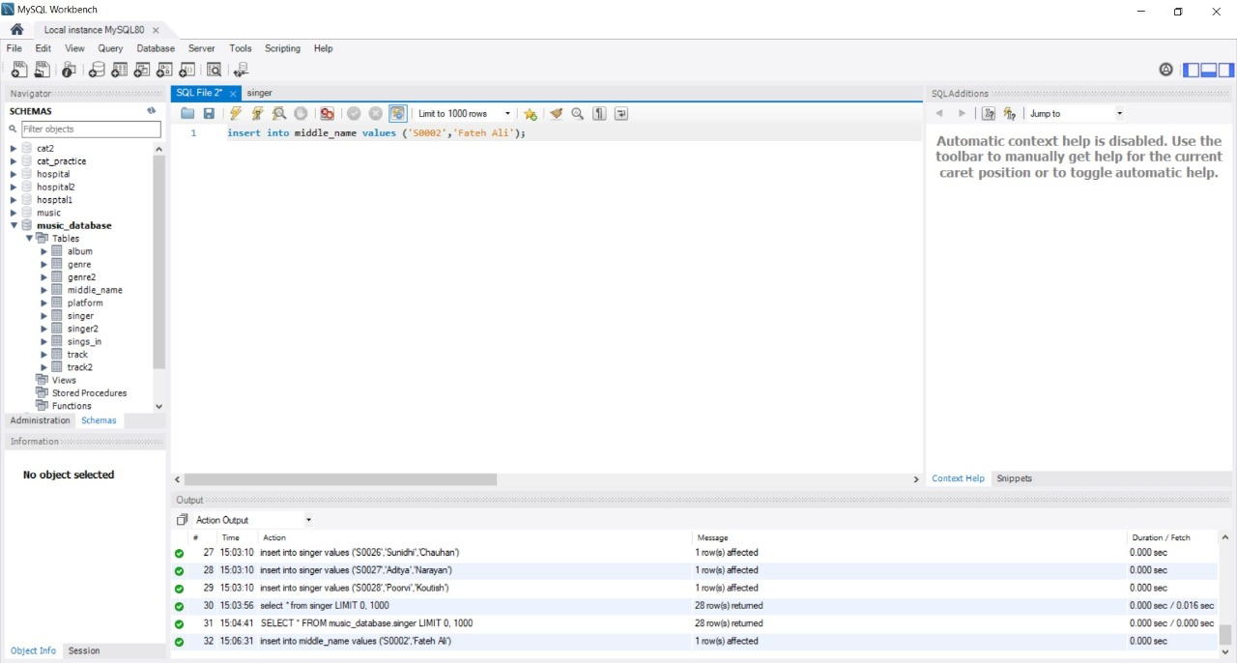
MIDDLE_NAME

Slide 27
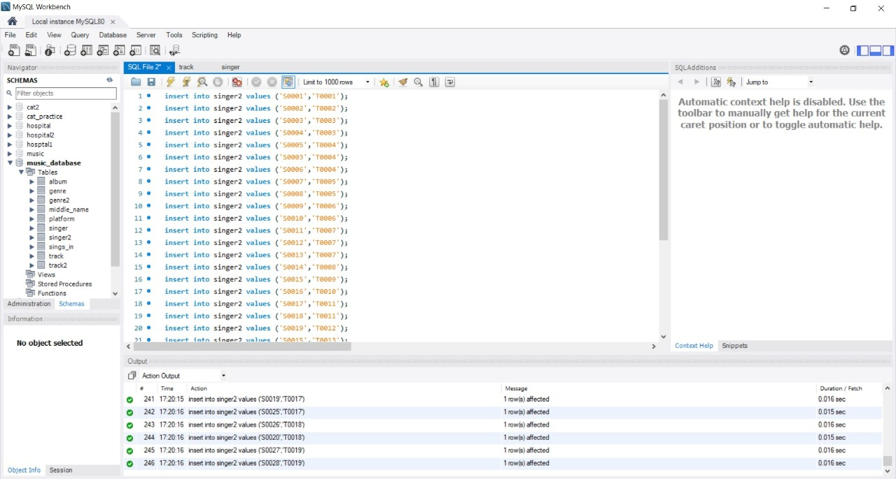
SINGER2

Slide 28
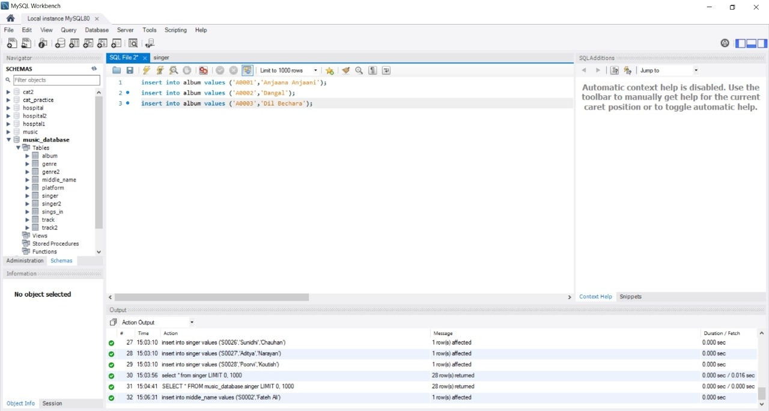
ALBUM

Slide 29
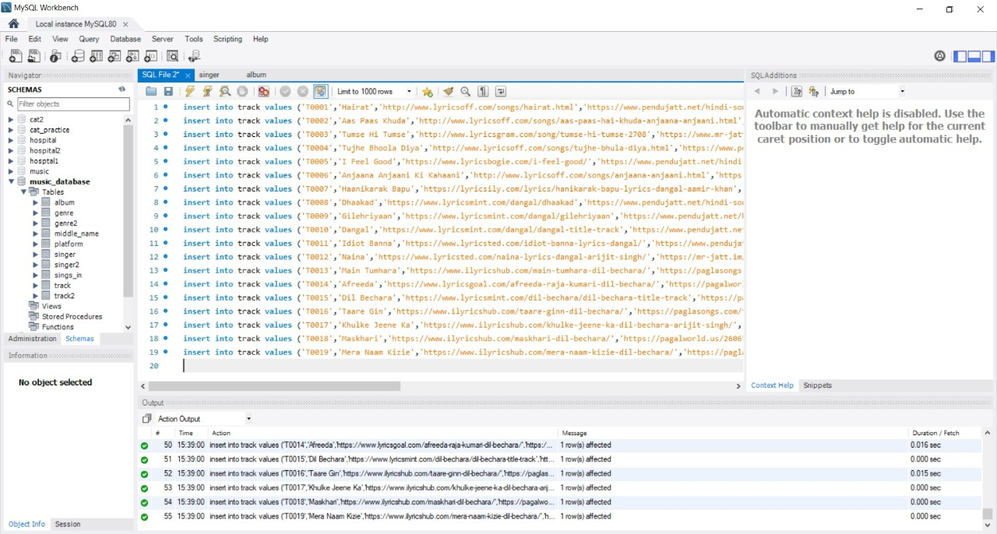
TRACK

Slide 30
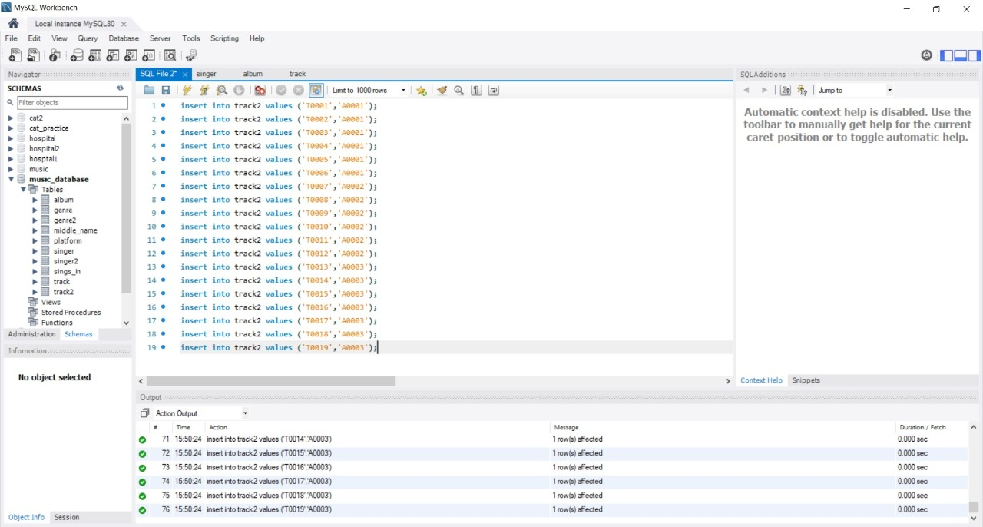
TRACK2

Slide 31

PLATFORM

Slide 32
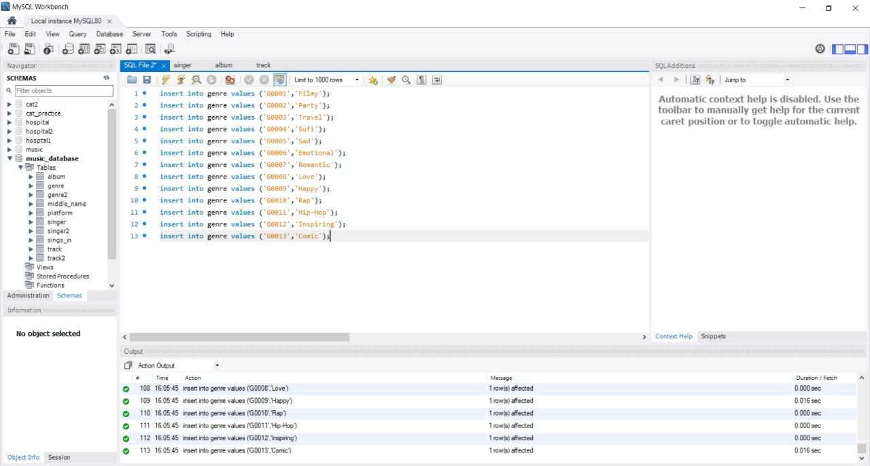
GENRE

Slide 33
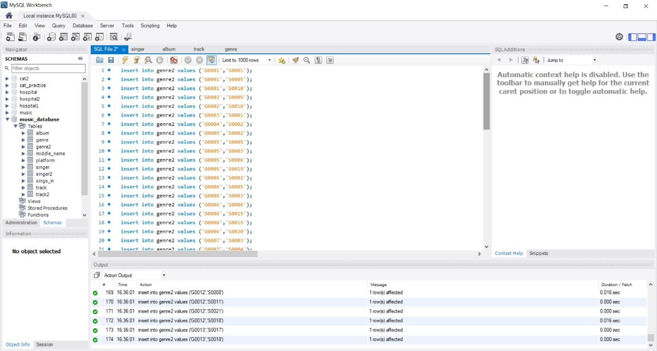
GENRE2

Slide 34
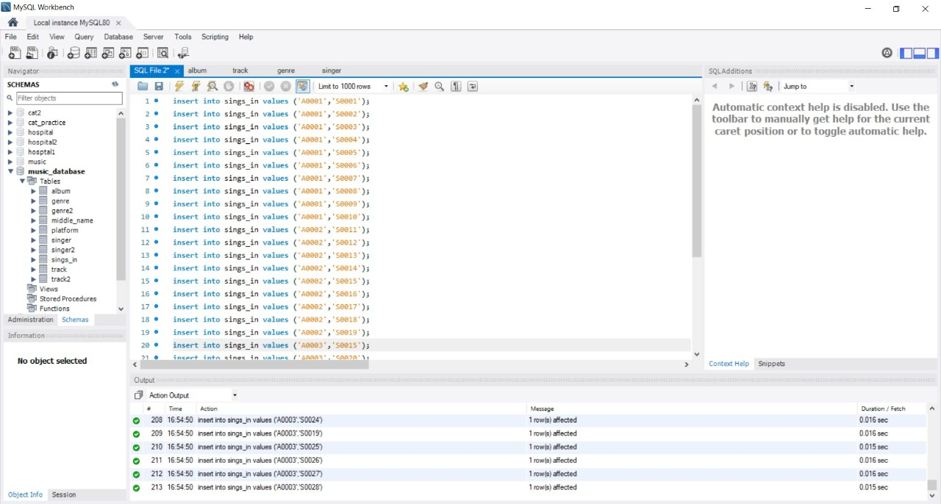
SINGS_IN

Slide 35
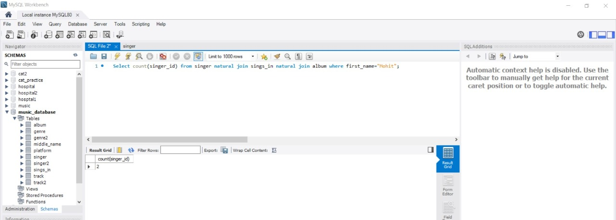
QUERIES RELATED TO THIS DATABASE
count the number of songs sung by singer having first name "mohit".(done by using Natural join)

Slide 36
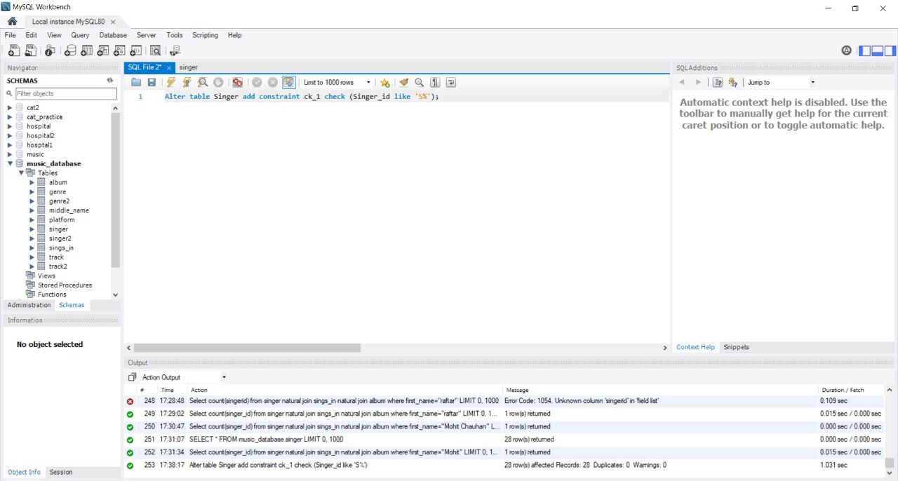
Add the check constraint to check if the singer id begins with "S".

Slide 37
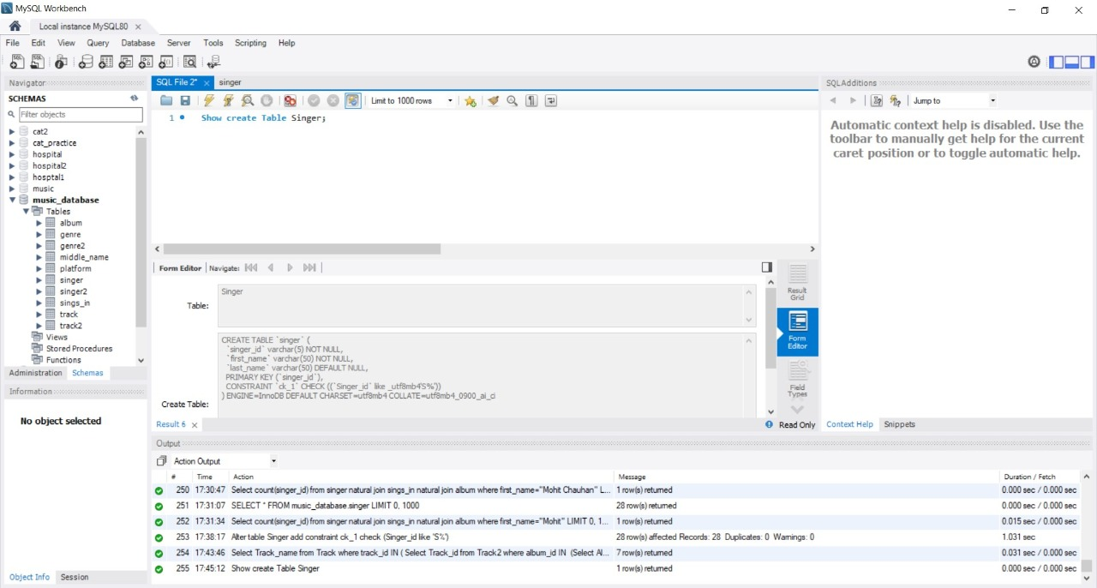

Slide 38
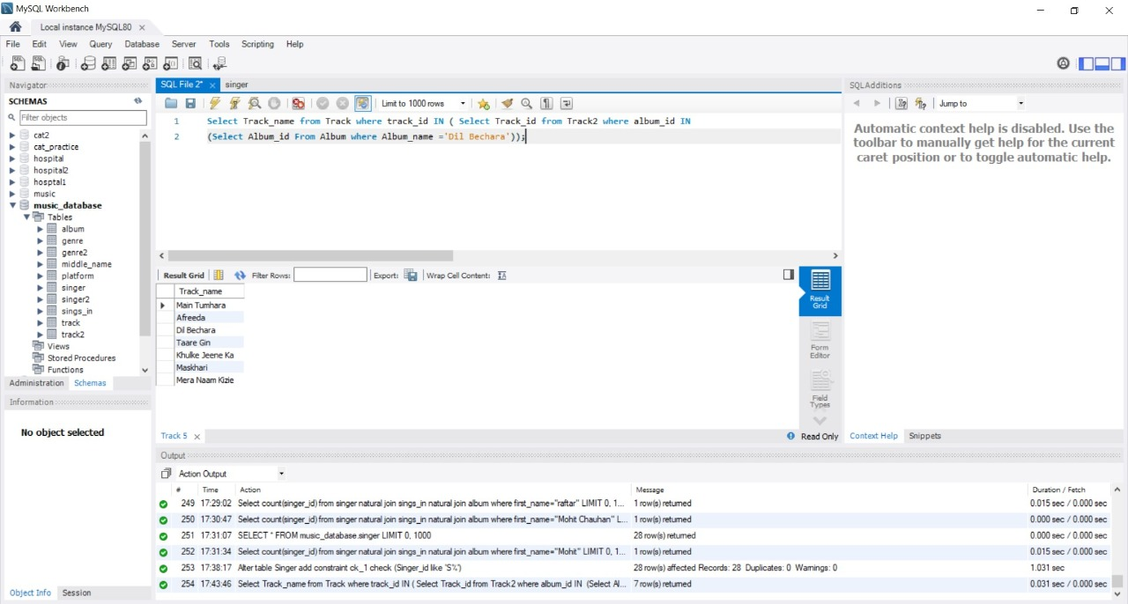
Using sub-queries, show the name of all the songs from album "dil bechara".

Slide 39
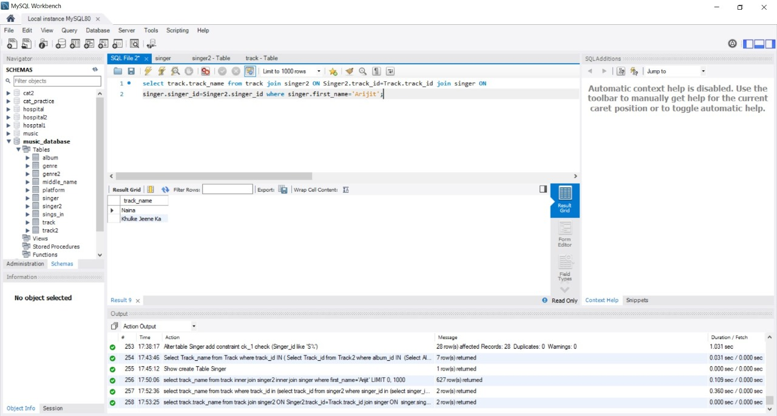
Show all the songs sung by "arijit".

Slide 40
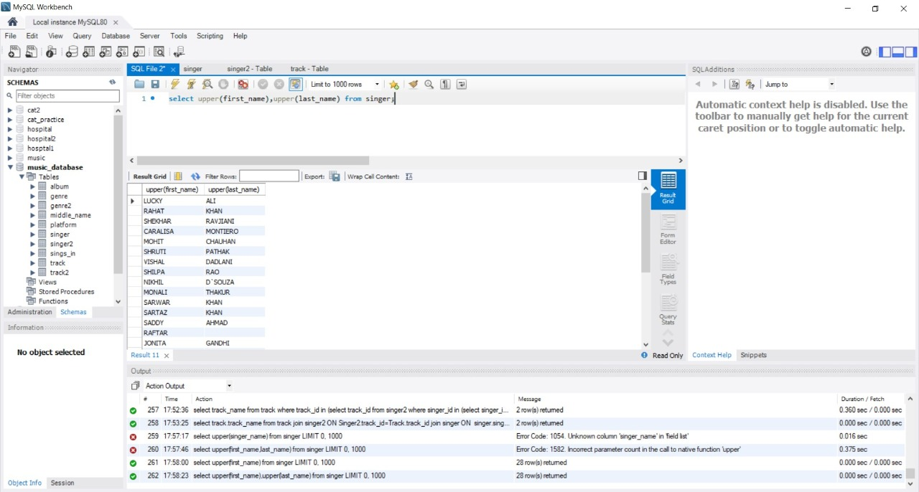
Show all the singer names in capital form.

Slide 41
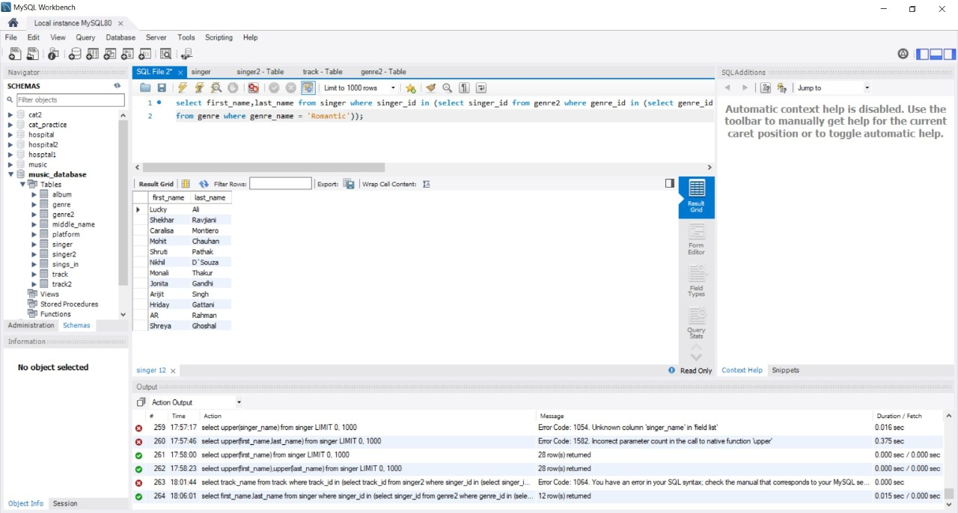
Show all the singers who sing romantic songs.

